Slide 1



Application of Boosted Decision Trees for High-Quality Track Selection in the Mu2e Experiment
Malik Farouh – City College of CUNY
July 2025-Present
Andrew Edmonds – York College of CUNY

Slide 2
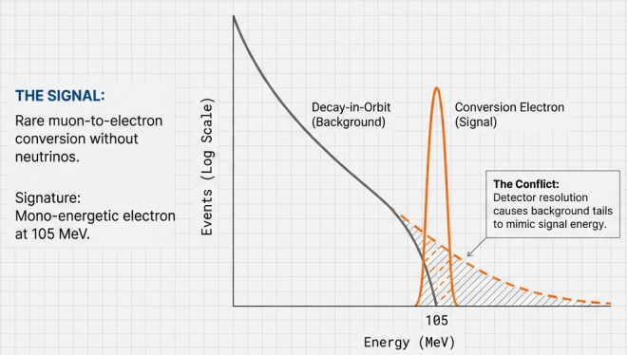
What is the problem?
Track quality selection is critical to reject mis-reconstructed backgrounds that can fake conversion electrons
Clear 105 MeV signal peak above steeply falling DIO background signal
Finite detector resolution causes DIO tail to extend into the signal region

Slide 3
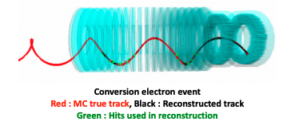
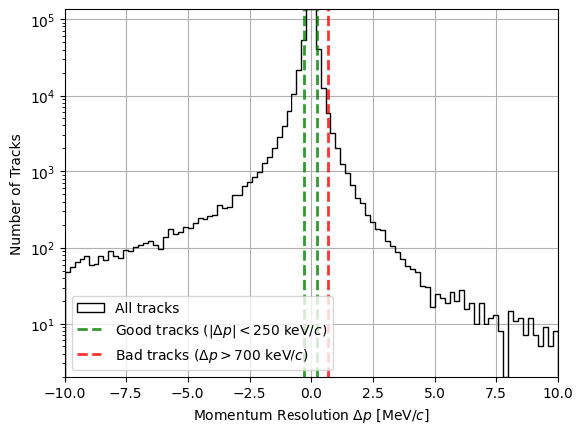
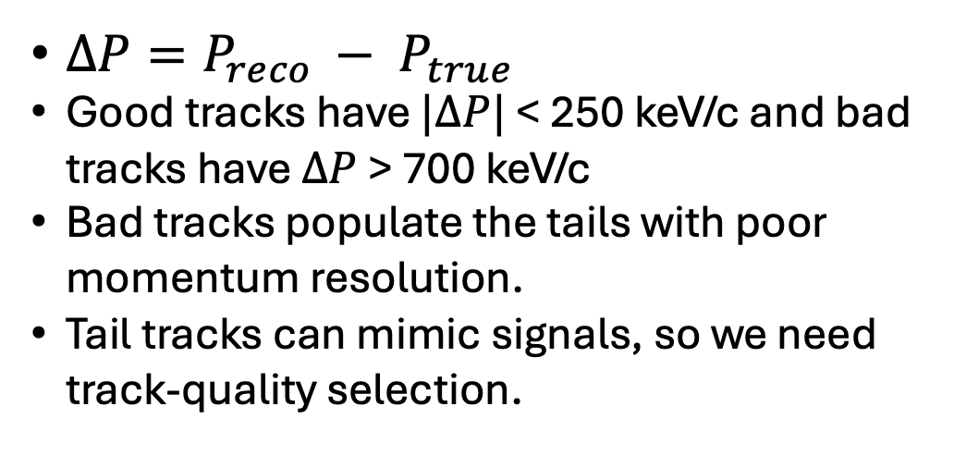
Momentum Resolution & Used Features
$∆P=P_{reco }− P_{true}$
Good tracks have $|∆P|$ < 250 keV/c and bad tracks have $∆P$ > 700 keV/c
Bad tracks populate the tails with poor momentum resolution.
Tail tracks can mimic signals, so we need track-quality selection.
Features | Brief Description
nactive | Number of hits used in track fit
factive | Fraction of hits successfully used in fit
fambig | Fraction of hits with left-right ambiguities
fstraws | Fraction of straws hit along track path
t0err | Uncertainty on track timing parameter
fitcon | Fit consistency (χ²-based quality metric)
momerr | Uncertainty on reconstructed momentum

Slide 4
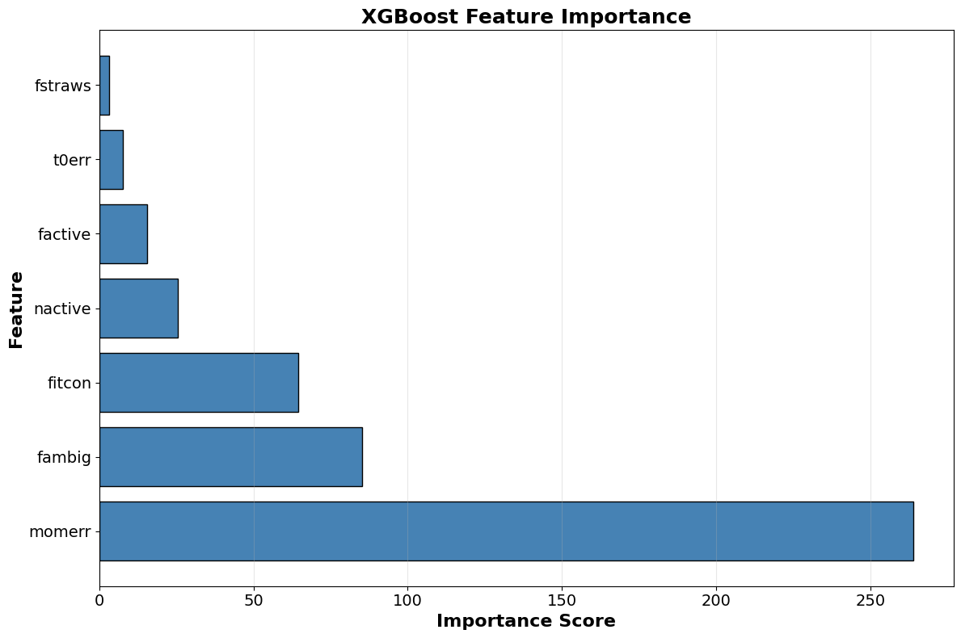
Machine Learning Approach
Challenge:
7 correlated features determine track quality
High-quality tracks to be selected
Simple cuts on individual features are inefficient
Approach:
Boosted Decision Trees (BDT) can learn complex patterns
Train on labeled examples of good vs. bad tracks
Model learns which feature combinations indicate quality
Artificial Neural Network (ANN) – Current
XGBoost BDT – this work

Slide 5
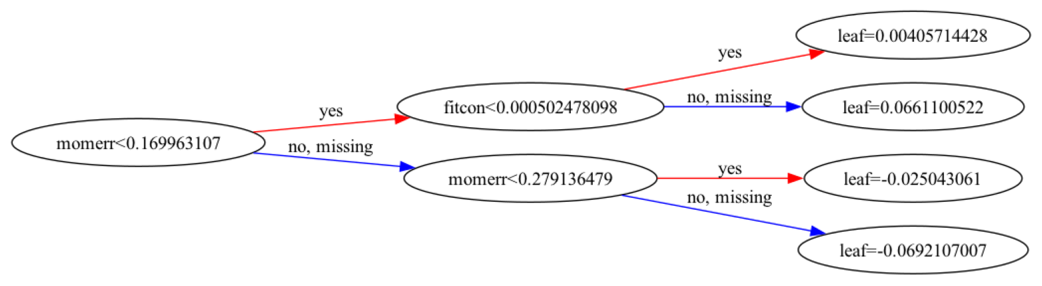
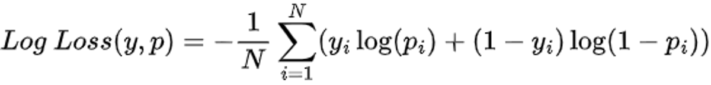


How Does a Boosted Decision Tree Work?
Single tree asks yes/no question about track features
Each path through tree ends in a leaf with a score
Boosting: Builds many trees iteratively, focusing on misclassified tracks
Combines hundreds of trees for final high-quality vs. low-quality classification
Optimizes using log loss to improve probability estimates
$y_{i}$ is the correct label
N=Total # of Tracks
$p_{i}$ is the predicted probability for track $i$

Slide 6
XGBoost & Hyperparameters Tuning
XGBoost: Optimized gradient boosting implementation
Hyperparameters are tunable settings that control model behavior
Key Parameters:
Maximum Depth: Controls tree complexity
Learning Rate: size for each tree’s contribution
# of Trees: Total number of trees in ensemble
Goal: Find optimal configuration through systematic testing Selected based on validation performance
Learning Rate
Max Depth
# of Trees
Training dataset: FlateMinusMix1BBTriggered dataset (MDC2020aw simulation) Contains electrons with flat momentum spectrum (80-105 MeV) from stopping target Preprocessed with RooUtil to flatten ntuple structure for ML training

Slide 7
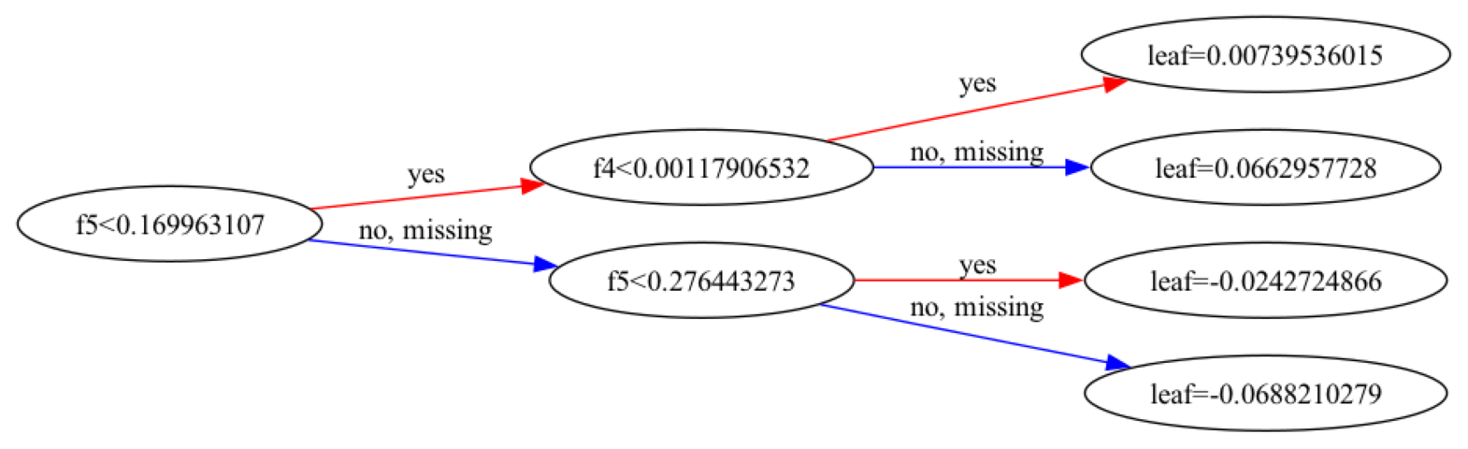
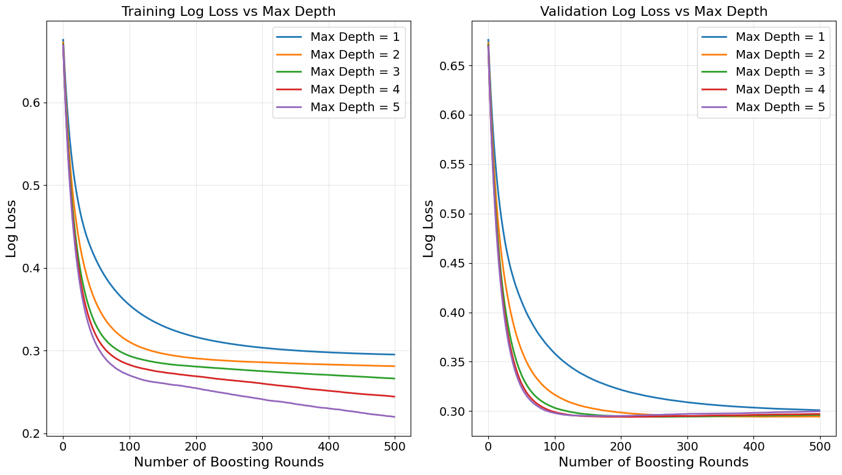
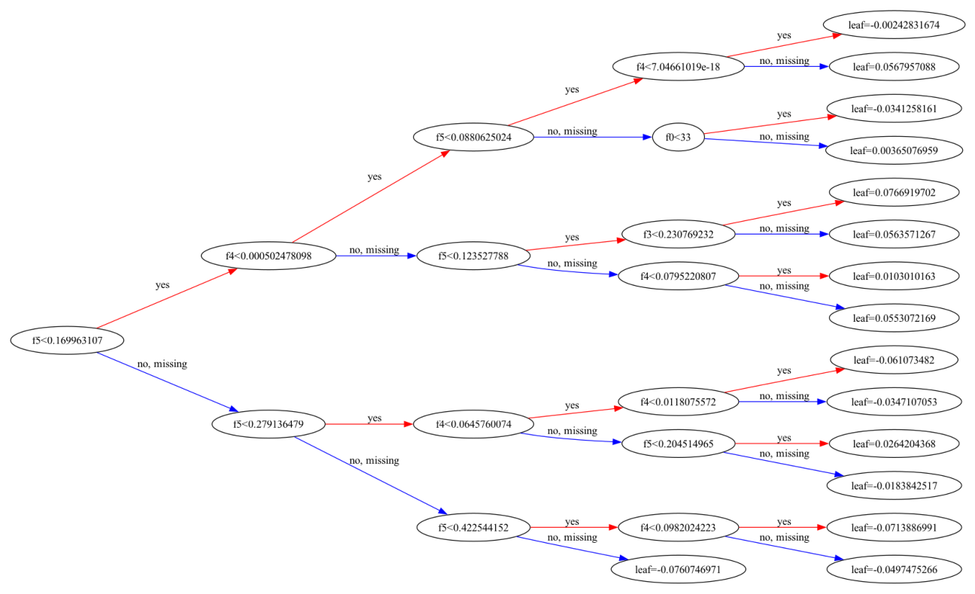
Maximum Depth
Controls maximum number of splits per tree
Training curves: Deeper trees achieve lower training loss (overfitting)
Validation curves: All depths converge to same performance (~0.30)
Selected: Max Depth = 2 achieves lowest validation loss (~0.2946)
Benefits: Faster training, better interpretability, reduced overfitting

Slide 8
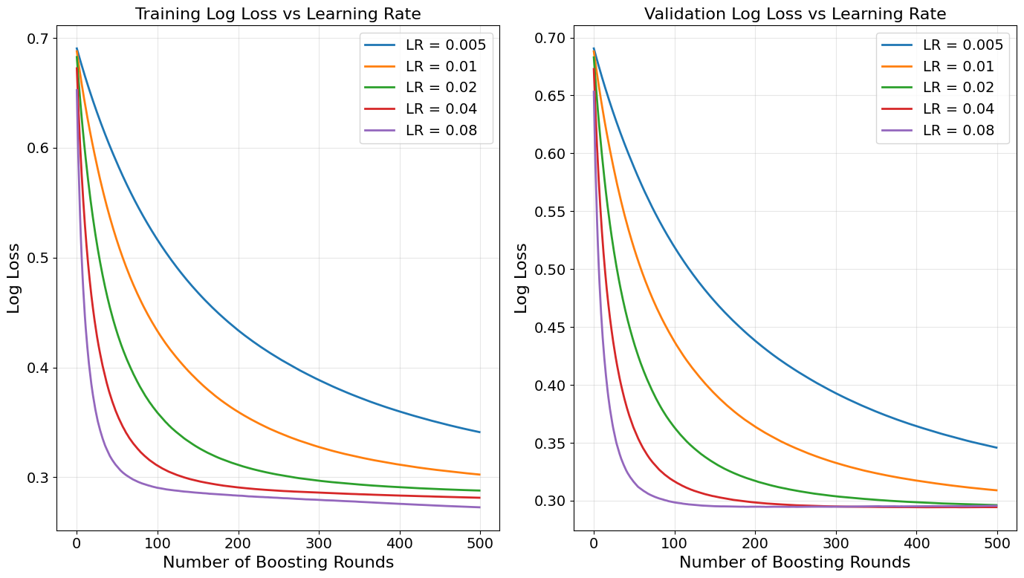
Learning Rate η
Learning rate (η) controls step size for each tree’s contribution
Low rates (0.005, 0.01): Slow convergence, need many rounds to learn
Fast convergence within ~100 rounds
Validation High rates (0.04, 0.08): performance: η=0.04 achieves best result (~0.2945)
Selected: η=0.04 – optimal balance between speed and accuracy
Small training-Validation gap indicates good generalization

Slide 9
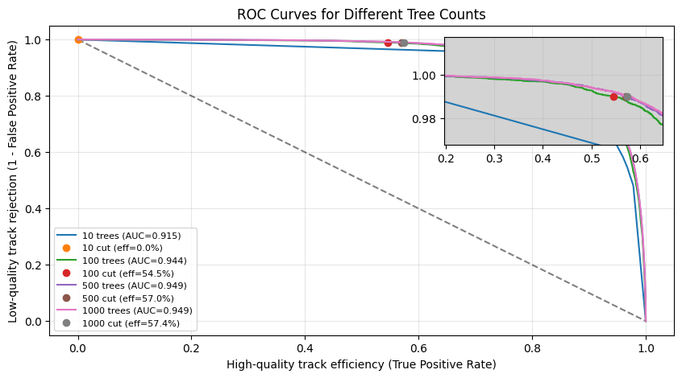
Receiver Operating Characteristic Curve
ROC curve shows tradeoff between signal efficiency and background rejection
X-axis: high-quality tracks retained
Y-axis: low-quality tracks rejected
Curves closer to top-right corner give better performance
AUC (Area Under Curve) summarizes overall classifier quality
Figure of Merit (FoM): 99% rejection of low-quality tracks (necessary to suppress DIO tail)
500 and 1000 trees perform identically ( both at 57% at FoM)
Selected: 500 trees – optimal performance without extra computational cost

Slide 10
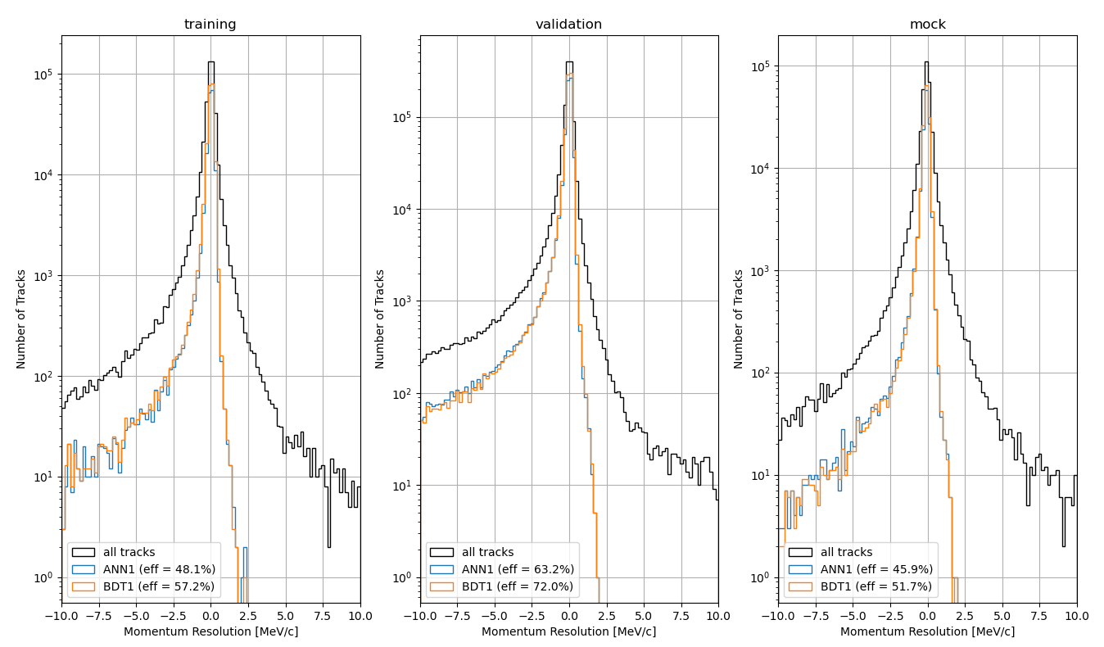
Momentum Resolution After BDT Selection
Flat momentum, at stopping target
Monoenergetic 105 MeV conversions
Full detector simulation with cosmics
BDT quality cut (trkqual ≥ 0.92) effectively narrows momentum resolution
Higher validation efficiency: Pure signal electrons are easier to reconstruct
Lower mock efficiency: Includes challenging backgrounds (cosmics, off-target)
Eff = 57.2%
Eff = 72%
Eff = 51.7%

Slide 11
BDT vs. ANN Performance Comparison
Model | AUC | Efficiency | Training Time | Processing New Dataset
ANN1 | 0.939 | 48.1% | 46.2s | 41s
BDT1 | 0.949 | 57.2% | 1.81s | 3.44s
Efficiency
At the 99% background-rejection operating point, the BDT retains 57.2% of good tracks, compared to 48.1% for the ANN
Runtime Comparison
Timing measurements performed in a Jupyter notebook
Both models run in the same Jupyter notebook with identical software settings
BDT1 trains substantially faster than ANN1
BDT1 is also faster when applied to new datasets

Slide 12
Next On The List
Develop a reliable XGBoost-to-TMVA conversion workflow
Deploy the converted model in the Mu2e art framework
Verify event-by-event agreement with the Python model

Slide 13

Summary
XGBoost BDT outperforms the current ANN in track-quality selection
At 99% background rejection, BDT retains ~9% more good tracks
Produces clean momentum resolution across all datasets
Trains and evaluates faster than ANN
Ready for large-scale Mu2e production pending TMVA integration
Reference: Mu2e-doc-55327
Thank you for your time! Happy to answer any question you have

